Slide 1

EMERGING SKILLS IN THE IT INDUSTRY ​
​A Data-Driven Analysis​
Anjani Sirivella
April 2023

Slide 2



In Association With:

Slide 3
Outline TEMPLATE
1
2
3
4
5
6
7

Slide 4
Outline
1
2
3
4
5
6
7
1
Executive Summary
5
Discussion
2
Findings & Implications
Introduction
6
Conclusion
3
Methodology
7
Appendix
4
Results
Charts, Dashboard

Slide 5


Executive Summary
1
2
3
4
5
6
7
The purpose of this report is to help identify future skill requirements, current trends, and demographic analysis on the survey respondents. This report provides insights for various stakeholders, including developers, businesses, educators, and policy makers. The data analysis reveals four major trends.
The first trend identified is the dominance of web programming languages in the near future. Python and Data Science are becoming increasingly important, while legacy languages like C++ and PHP are gradually falling out of interest. The second trend indicates that open source databases are becoming more popular compared to commercial databases, with non-relational databases seeing increased usage in the future. However, relational databases still hold a leading position in the near future.
The third trend observed is that Windows and Linux are still the main developing platforms in the foreseeable future. Additionally, the transformation to cloud computing is a non-reversible process. Finally, the fourth trend identified is that jQuery is quickly losing market share, showing a lack of interest in its future development. React.js and Vue.js are becoming the new standard for web frame development.
Overall, these findings provide valuable insights into emerging skill requirements for IT professionals. Organizations and individuals looking to stay competitive should focus on web programming languages, open source databases, and cloud computing, as well as keep up-to-date with the latest web frame trends. These trends indicate a continued shift towards open source and cloud-based technologies, with a growing emphasis on data science and Python proficiency.
Notes:
This report provides insights for various stakeholders, including developers, businesses, educators, and policy makers. Developers should focus on enhancing their skills in high-demand technologies such as Typescript, SQL, NoSQL, Python, and web development. Businesses should adapt to changing technology preferences and upskill their talent. Educators should emphasize teaching high-demand technologies to prepare students for the job market, while policy makers should address gender and economic issues in the industry.
The report identifies four major trends. Firstly, web programming languages like Python and data science are becoming increasingly important. Secondly, open source databases are gaining popularity, especially non-relational databases. Thirdly, Windows and Linux remain the main developing platforms, and the transformation to cloud computing is irreversible. Finally, jQuery is losing market share, while React.js and Vue.js are becoming the new standards for web frame development.
In conclusion, these findings suggest a continued shift towards open source and cloud-based technologies, with a growing emphasis on data science and Python proficiency. Organizations and individuals should focus on web programming languages, open source databases, and cloud computing to stay competitive and keep up-to-date with the latest web frame trends.

Slide 6

Introduction
1
2
3
4
5
6
7
The aim of the analysis is to identify emerging skills and current trends on collected data. The main results of an analysis conducted is presented in the following slides.
The analysis provides key insights into the most popular programming languages, databases, and other technologies at the time the data was collected. Additionally, it uncovers attitudes regarding which technologies are expected to become popular in the future. The analysis also highlights the demographics of developers, including the gender gap among them.
These findings are particularly useful for current and aspiring developers, recruiters, educators, and policy makers.

Slide 7
Methodology
1
2
3
4
5
6
7
Data Collection:
Data on the top programming skills in demand is collected from various sources including: job postings, training portals, Surveys
Done by scraping internet web sites and accessing APIs to collect data in various formats like .csv files, excel sheets, and databases.
Data Source: 2019 Stack Overflow Developer Survey
Data Wrangling:
Making the data ready for analysis using data wrangling techniques
Techniques include data cleaning, data normalization, data imputation, and data reduction
Done using SQL and Python’s pandas library
Data Analysis:
Apply statistical techniques to analyze the data, including exploratory data analysis, descriptive analysis, and inferential analysis
Data Visualization: Bring all information together by using IBM Cognos Analytics to create dashboard.

Slide 8

Results
1
2
3
4
5
6
7
Examine the trends in:
Programming Languages
Databases
Platforms
Web Frames

Slide 9
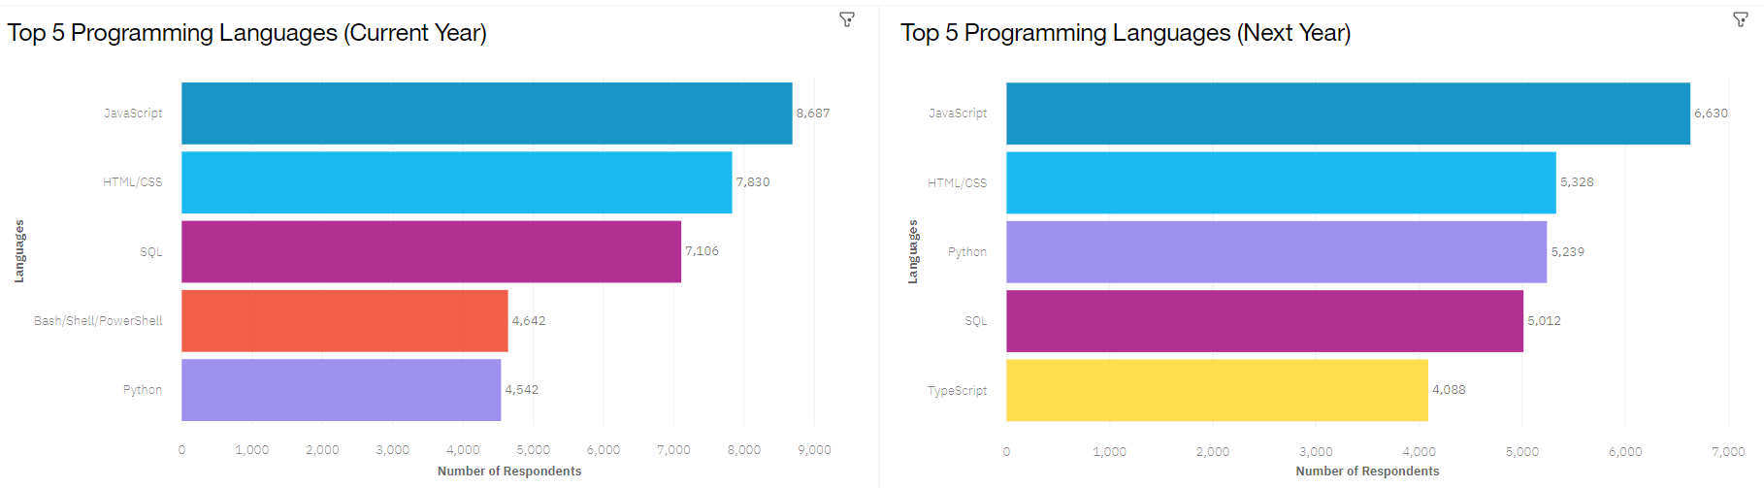
Programming Language Trends
1
2
3
4
5
6
7

Slide 10
Findings
1
2
3
4
5
6
7
Implications
JavaScript and HTML/CSS are popular and will remain so next year.
Python is quickly gaining interest
SQL remains popular
Interest in Bash/Shell/Powershell is decreasing, pushed off the top 5 list for next year
Web development languages (JavaScript, HTML/CSS) will remain dominant, with Typescript catching up
Python's popularity is rising due to the growth of AI and ML work.
SQL remains the preferred language for big data storage and querying; it looks like it will continue to be the preferred language in the near future.
Command shell and scripting language (Bash/Shell/Powershell) are falling out of favor
Programming Languages

Slide 11
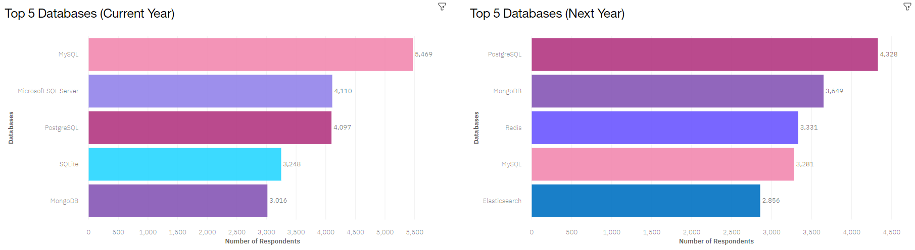
Database Trends
1
2
3
4
5
6
7

Slide 12
Findings
1
2
3
4
5
6
7
Implications
PostgreSQL is the most desirable database of 2020
MySQL is the most desirable database of 2019, with Microsoft SQL Server ranking 2nd, but both lost its lead by next year
In 2019, Microsoft SQL Server and SQLite disappear from top 5 next year
MongoDB has gaining interest
Redis and Elasticsearch enters the top 5 rankings
Open-source databases are increasingly preferred by developers
NoSQL databases are gaining popularity, denoting a need for handling non-relational and unstructured data
Competence in both NoSQL and SQL database programs is essential for data analysts
Database Trends
Notes:
SQL Server, and MongoDB and Redis are the top NoSQL databases.
PostgreSQL, MySQL is SQL
MongoDB, Redis, Elasticsearch is NoSQL
Microsoft SQL Server is SQL, SQLite is NoSQL
Reasons:
PostgreSQL supports Python, PHP, Perl, Tcl, Net, C, C++, Delphi, Java, JavaScript (Node. js), and more. SQL Server is more limited, offering support for Java, JavaScript (Node. js), C#, C++, PHP, Python, and Ruby.
While relational databases are still popular, NoSQL databases are on the rise.
Within relational databases, PostgreSQL overtook MySQL and Microsoft SQL Server. (PostgreSQL supports more languages)
Within NoSQL databases, MongoDB is top with Redis following.
Open source databases are leading the future

Slide 13


Dashboard
1
2
3
4
5
6
7
The link provided contains an interactive Cognos dashboard that summarizes:
Current technology trends
Future technology trends, and
Demographics of survey respondents.
OPEN COGNOS DASHBOARD
The next three slides show static screenshots of the dashboard.

Slide 14
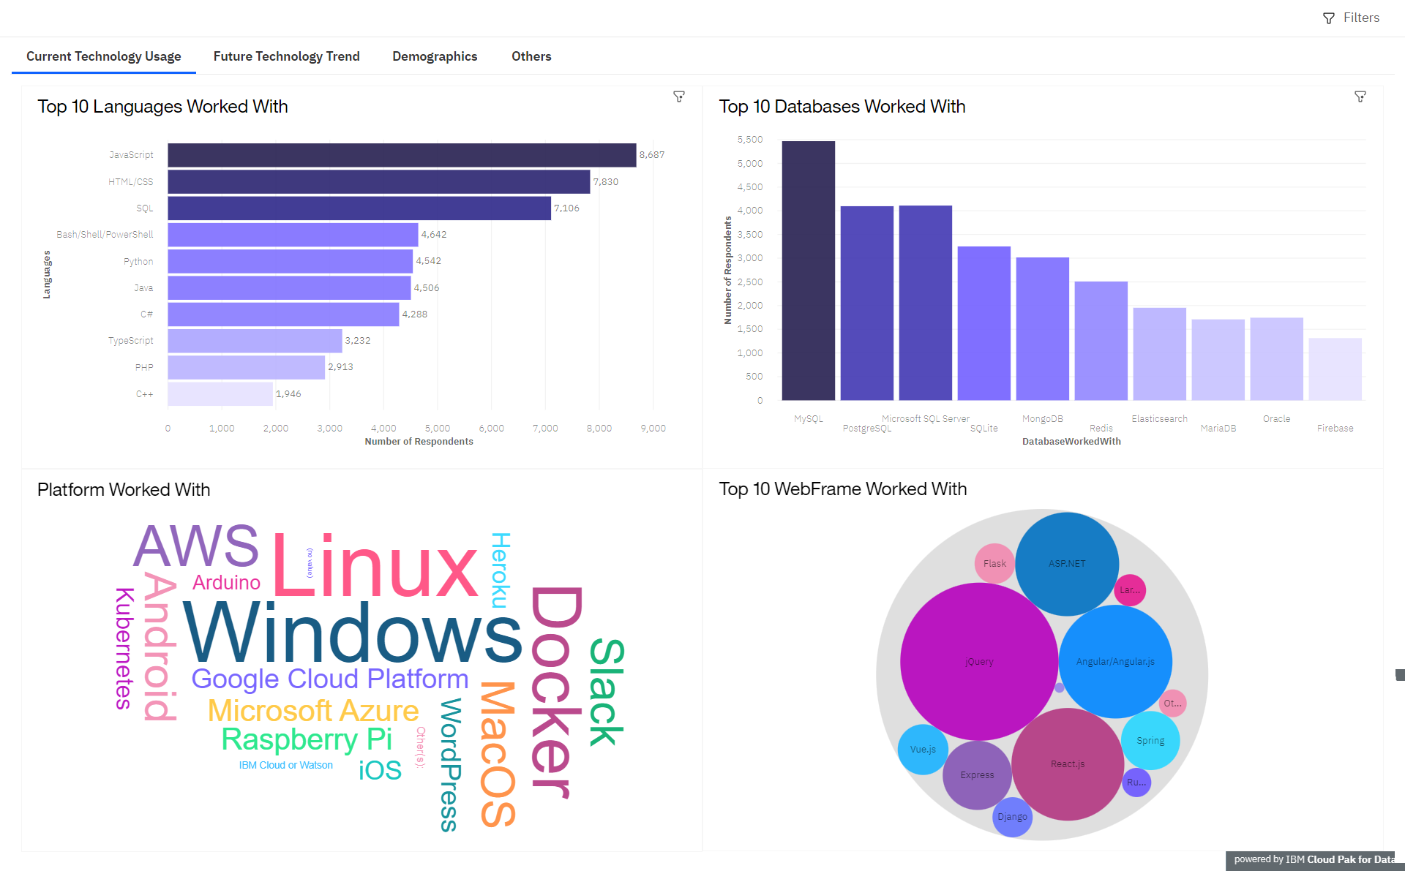
Dashboard Tab 1
1
2
3
4
5
6
7

Slide 15
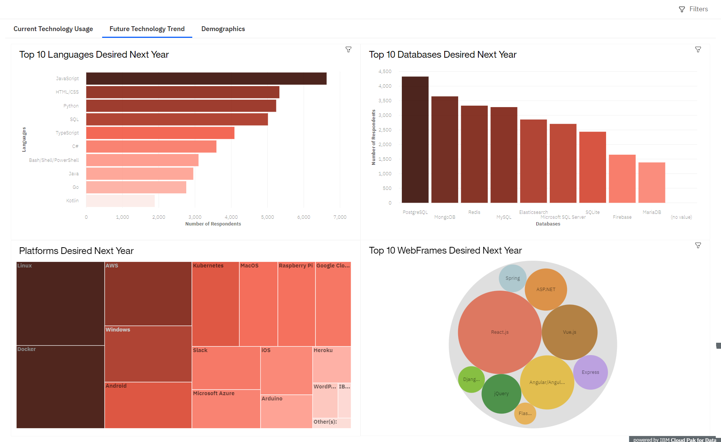
Dashboard Tab 2
1
2
3
4
5
6
7

Slide 16
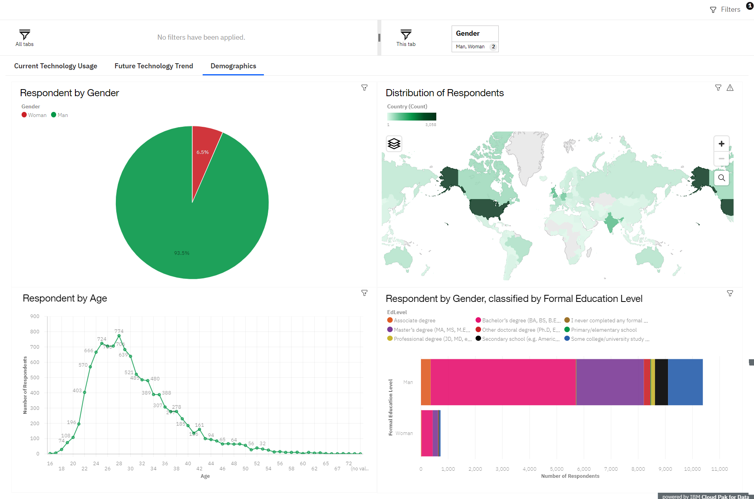
Dashboard Tab 3
1
2
3
4
5
6
7

Slide 17

Discussion
1
2
3
4
5
6
7
The findings provide insights into:
The most in-demand developer technologies
The technologies that prospective developers and data professionals should learn
The technologies that educators should focus on teaching in the future
The distribution of annual compensation for developers
The demographic of developers and whether there is a gender representation gap

Slide 18
Overall Findings & Implications
1
2
3
4
5
6
7
Findings:
Javascript and HTML/CSS continue to have high usage and interest, with Typescript also gaining interest.
Python is seeing increasing interest.
SQL remains highly used and popular, with PostgreSQL becoming the most desired database program for the future, despite MySQL having the highest usage in 2019.
NoSQL databases, particularly MongoDB, are gaining interest.
Despite slightly higher median compensation for women, there is still a severe gender representation gap in technology.
There is a technology divide between countries.
Implications:
Web development remains a sought-after skill. Consider learning Typescript with Javascript and HTML/CSS.
Data professionals should enhance competence with SQL and NoSQL database programs like MongoDB and Python for handling big data and performing AI and ML work.
Businesses should adapt to evolving technology preferences in terms of talent acquisition and development.
Policy makers, educators, and organizations should address the gender representation gap and technology divide between countries.
Notes:
JavaScript, Elm, TypeScript are used in front-end web development
JavaScript, Scala, Python, Go, Ruby are useful for back-end web development
Swift, Java, Objective C, JavaScript serve in mobile development
Unity, TypeScript are typical in game development
Scala, Go, Python are popular for developing desktop applications
Go, Rust are perfect for systems programming

Slide 19


Conclusion
1
2
3
4
5
6
7
The findings from the survey provide valuable insights for various stakeholders, including current and aspiring developers, businesses, educators, and policy makers.
Developers should focus on enhancing their skills in high-demand technologies like Typescript, SQL, NoSQL, Python, and web development.
Businesses should adapt to changing technology preferences and focus on upskilling their talent accordingly.
Educators should place emphasis on teaching these high-demand technologies to prepare students for the job market.
Policy makers should work to address gender and economic issues in the technology industry.

Slide 20

Appendix
1
2
3
4
5
6
7
List of Figures:
Job Postings
Popular Languages

Slide 21
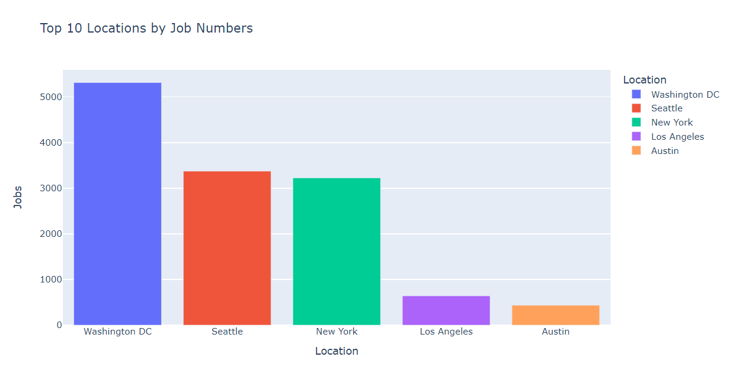
Job Postings
1
2
3
4
5
6
7

Slide 22
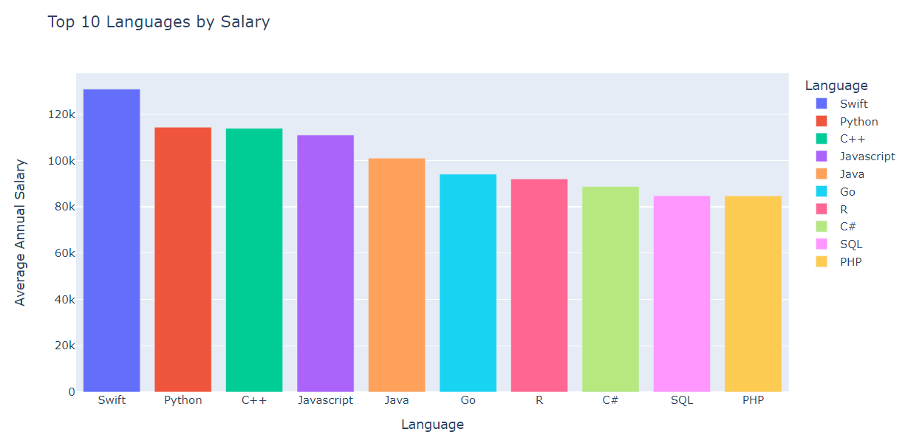
Popular Languages
1
2
3
4
5
6
7

